Slide 1
Section 1.3
The Limit of a Function

Slide 2
Overview
In this section, we will extend the concepts and results obtained from sequences to functions.
A sequence is a special function
defined on a number set
.
The limit of a sequence can only be the
limit while n to (positive)
infinity.
However, for a function
, its independent variable is x and
can change continuously (x can take any value in its defined interval),
and may have various limits.

Slide 3
The concept of limit of a function
Notation
: an interval
f (x) : a function
x : independent variable
we always use I to express an interval (may be finite or infinite, open, closed or half open).
Function
is defined in an interval I ,
then its independent
variable x has many changes in several ways:

Slide 4
The concept of limit of a function
We mainly discuss the case
Limit of a function for x tending to infinity
and the other two
cases are similar.
Definition (Limit of a function as x tends to positive infinity)
Suppose that A is a constant and the function
If
such that
for all
then we say that f (x) has a limit or the limit of f (x) exists as x approaches infinity,
and A is called the limit of f (x), denoted by
, or
as

Slide 5
The concept of limit of a function
The geometric meaning of the definition
as
:
,
, s. t.
holds for all
.
Notes:
While x is large enough, function f(x) will be bounded by A+e and A-e, there for |f(x)-A|<e

Slide 6
The concept of limit of a function
as
:
,
, s. t.
holds for all x < -X.
as
:
,
, s. t.
holds for all | x |>X.
Notes:
While x is large enough, function f(x) will be bounded by A+e and A-e, there for |f(x)-A|<e

Slide 7
The concept of limit of a function
as
:
,
, s. t.
holds for all
.
as
:
,
, s. t.
holds for all x < -X.
as
:
,
, s. t.
holds for all | x |>X.
Remark It is easy to prove the relationship that
.
Can you prove the above proposition ?

Slide 8
The concept of limit of a function
as
:
,
, s. t.
holds for all | x |>X.
Example
Prove
, find X
Proof
we require
and we need only
or
.
Let’s taking
we have
for all
.
Notes:
While x is large enough, function f(x) will be bounded by A+e and A-e, there for |f(x)-A|<e

Slide 9
The concept of limit of a function
Limit of a function for
tending to a finite value
Observe the behavior of function
as

Slide 10
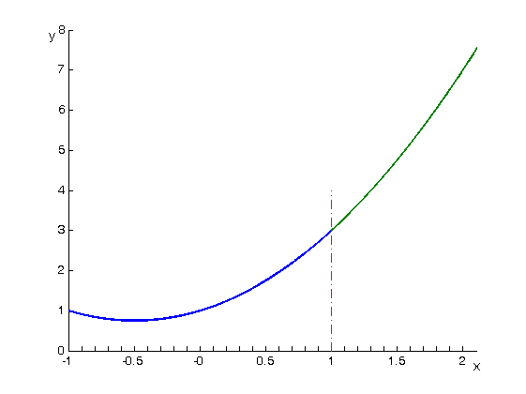
The concept of limit of a function
Limit of a function for
tending to a finite value
Observe the behavior of function
,
as
.
Since, function
do not have definition
at point
,
so we make a table as
1.25
1.1
1.01
1.001
1.0001
…
1
3.813
3.310
3.030
3.003
3.0003
…
?
x
…
0.9999
0.999
0.99
0.9
0.75
…
2.9997
2.997
2.970
2.710
2.313
It seems that while
,
.

Slide 11
The concept of limit of a function
Limit of a function for
tending to a finite value
Observe the behavior of function
as
We make a table as
1.0
0.5
0.1
0.01
…
0
0.84147
0.95885
0.99833
0.99998
…
?
…
-0.01
-0.1
-0.5
-1
…
0.99998
0.99833
0.95885
0.84147
It seems that while
,
.

Slide 12
The concept of limit of a function
Limit of a function for
tending to a finite value

Slide 13
The concept of limit of a function
Limit of a function for
tending to a finite value
Observe the behavior of function
as

Slide 14
The concept of limit of a function
Limit of a function for
tending to a finite value
Limit of a function for
tending to a finite value
Observe the behavior of function
as

Slide 15
The concept of limit of a function
Definition (Neighborhood[邻域])
Notes:
If the length of interval is not very important, then the delete in the neighborhood can be omitted.

Slide 16
The concept of limit of a function
Definition (Limit of f(x) as x tends to a finite value)
Suppose that the function
or
is a constant.
If
such that
holds for all
Then, we say f (x) has a limit at x = x₀, and A is called the
limit of f (x) as x→x₀ . denoted by
or
as
, such that
for all

Slide 17
The concept of limit of a function
Geometric interpretation of the definition
, such that
for all

Slide 18
The concept of limit of a function
, such that
for all
Example Prove
Proof
For all
we are looking for a
such that
holds for all x
which satisfies
While
, we have
, so
Hence, we need only
Then, for all
,
, such that
holds for all
.
Finish.

Slide 19
The concept of limit of a function
, such that
for all
Example Prove
Proof
For all
we are looking for a
such that
holds
for all
which satisfies
Since, by
,
we can not obtain the required
directly,
We need to change the left side of this inequality.

Slide 20
The concept of limit of a function
, such that
for all
Example Prove
Proof (continued)
Because
we can restrict to be kept in
a small neighborhood of
.
For example
or
.
If so, we have
Thus
.
So,
requires only
or
.
Therefore,
,
such that
Finish.

Slide 21
The concept of limit of a function
Question
such that
for all
do we still have

Slide 22
The concept of limit of a function
One-Side limits
Definition
If
,
, such that
for all
satisfying
, then
is called the right limit [右极限] of
as
denoted by
, or
as
.
In this case, we say that when
, the right limit of
exists and is A.
Similarly, we can define the left limit [左极限], that is
, or
as
.
:
,
, such that
for all
:
,
, such that
for all

Slide 23
The concept of limit of a function
One-Side limits
Observe the behavior of function
as

Slide 24
The concept of limit of a function
Remark It is easy to prove the relationship that
This relation shows that, if one of the one-side limits does not exist, or if both of them exists but are not equal, then the limit of f (x) does not exist.

Slide 25
The concept of limit of a function
Aggregation principle of functional limits
Taking a sequence {x_{n}} such that
as
is also a sequence.
If
It is
obviously that
Conversely, if holds for any sequence
x_{n} → x₀ as n →∞, then we have

Slide 26
The concept of limit of a function
Aggregation principle of functional limits
Theorem (Heine's theorem) Consider a function
then
for any sequence
Remark The corresponding conclusion of the Heine’s theorem is also suitable for the case x → x₀⁺ , x → x₀⁻ ,
x → +∞, x → -∞ and x → ∞.

Slide 27
The concept of limit of a function
Aggregation principle of functional limits

Slide 28
The concept of limit of a function
Example Prove that when
the limit of the function
does not exist.
Proof
Taking the sequence
,
,
as
, and
, we have
.
Again, taking
,
,
as
, and
,
we have
.
By Heine’s theorem, we have the conclusion follows.

Slide 29
The properties of functional limits
Theorem (Properties of functional limits) Suppose that
.
(1) (uniqueness) The limit of f (x) must be unique as .
(2) (local boundedness) f (x) is bounded in the deleted neighborhood of x₀ .
That is,
and
such that
for all
such that
.

Slide 30
The properties of functional limits
Theorem (Properties of functional limits) Suppose that
.
(3) (Local preservation of sign)
If
, then
and a constant
such that
for all
such that
.

Slide 31
The properties of functional limits
Theorem (Properties of functional limits) Suppose that
.
(4) (Local isotone of sign)
If
and
such that
for all
such that
, then
.
.

Slide 32
The properties of functional limits
Theorem (Properties of functional limits) Suppose that
.
(5) (Sandwich theorem)
If
and
such that
for all
such that
, then
.

Slide 33
The properties of functional limits
Theorem (Properties of functional limits) Suppose that
.

Slide 34
Operation rules of functional limits
Then

Slide 35
Operation rules of functional limits
Remark The conclusions of the last theorem and its corollary are also correct for the case x → x₀⁺ , x → x₀⁻ ,
x → +∞, x → -∞ and x → ∞.

Slide 36
Operation rules of functional limits
Example Find
An indeterminate form of type
Solution

Slide 37
Operation rules of functional limits
Example Find
An indeterminate form of type
Solution

Slide 38
Operation rules of functional limits
Example Find
an indeterminate form of type
Solution

Slide 39
Operation rules of functional limits
Theorem (Composition of rational operation rules)
Question: Why does the theorem need the condition :
?

Slide 40
Operation rules of functional limits
Example

Slide 41
Operation rules of functional limits
Example Find
An indeterminate form of type
Solution
Let
By means of the composition of
operation rule we obtain

Slide 42
Two important limits
Proof
Let’s assume that
and draw a unit circle.
It is clear that
area(⊿OAB) < area(sector OAB) < area(⊿OAC)
so that, we have
.

Slide 43
Two important limits
Proof (continued)
Since
,
while
,
,
we have
or
.
It is easy to prove
By sandwich theorem, we have
.
Similarly, we can also proof that
.
Then we have the conclusion.

Slide 44




Two important limits
Example: Find
.
Solution
Finish.
Notes:
It is easy to prove that the limit of cos[x] as x to 0 is 1.

Slide 45
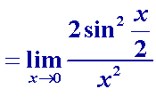


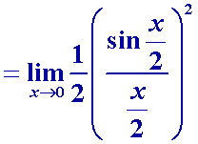
Two important limits
Example Find
.
Solution
Finish.
Notes:
It is easy to prove that the limit of cos[x] as x to 0 is 1.

Slide 46




Two important limits
Example Find
Solution Let
, so that
.
We can restricting
since
.
Hence the variable
can only approach 0 as
.
Thus,
.
Finish.
Notes:
It is easy to prove that the limit of cos[x] as x to 0 is 1.

Slide 47

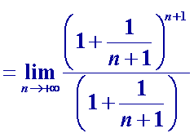

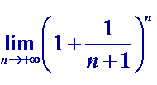


Two important limits
Proof
Suppose that
, then
.
Since
as
and
,
so that
,
.

Slide 48





Two important limits
Proof (continued) we have
.
Let
, then
while
.
Hence
.
So
.
Finish.

Slide 49
Two important limits
Example Find
Solution
Let
that is,
and
Finish.

Slide 50
Two important limits
Example Find
Solution
Finish.

Slide 51
Review
The concepts of limit for a function while independent variable tends to infinity
The concepts of limit for a function while independent variable tends to a value
The concepts of one-side limit
The properties and operation rules of functional limits
Two important limits

